Slide 1
City Digital Twin Knowledge Graph
Urban Data Research Centre
Notes:
Hello, I'm Anderson Wong from the University of Toronto's Urban Data Research Centre and I'm here today to give you an overview of our City Digital Twin knowledge graph.

Slide 2
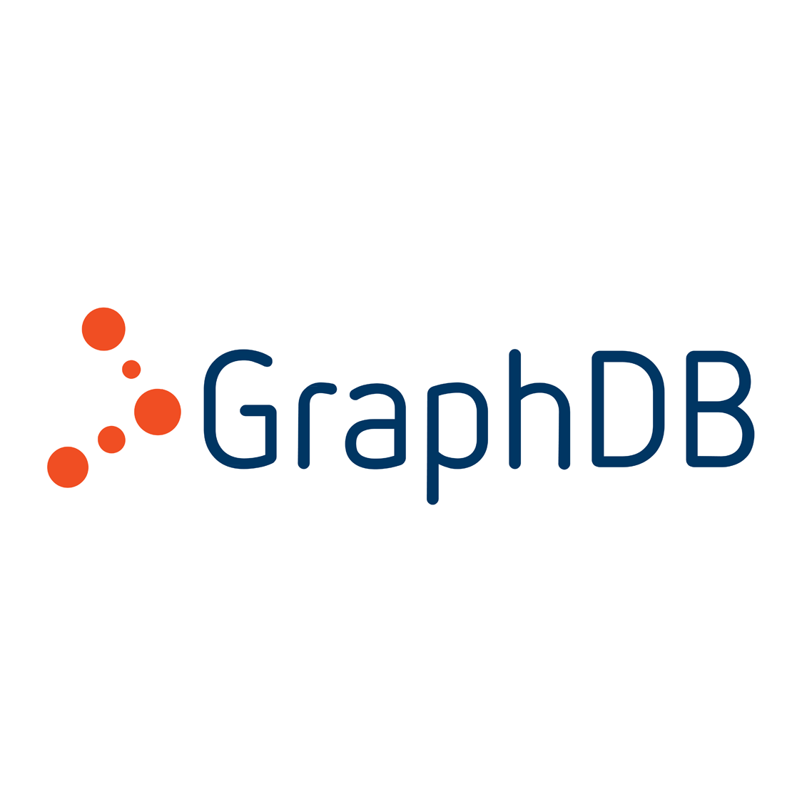
Overview
What is a graph database?
What is an ontology?
How can we use ontologies to represent data in a graph database?
How can we use the data in a graph database?
Notes:
I've structured this presentation to answer 4 main questions that will give you a better understanding of how the City Digital Twin knowledge graph works. What is a graph database? What is an ontology? How can we use ontologies to represent data in a graph database? And how can we use the data in a graph database?

Slide 3

What is a Graph Database?
A database that stores entities and their relationships
Graph databases can use RDF triplestores to structure information, unlike relational databases which use tables, rows, and columns
A triplestore consists of a subject, predicate, and object
Person | Age | Gender
Alex | 21 | male
Becky | 16 | female
Carl | 32 | male
Alex hasAge 21
Becky hasAge 16
Carl hasGender male
Notes:
Firstly, what is a graph database? Essentially, it is a database that describes information as entities and their relationships that can be structured as RDF triplestores instead of the usual tables, rows, and columns used by relational databases. A triplestore consists of a subject, predicate, and object where the predicate is used to show the type of relationship between the subject and the object. For example, here, you can see a simple table of data containing a list of people, their ages, and their gender, similar to what you might find in a typical relational database. Instead of using a table structure, a graph database could use triplestores to describe the same information (e.g. Alex hasAge 21 where Alex is the subject, hasAge is the predicate, and 21 is the object).

Slide 4
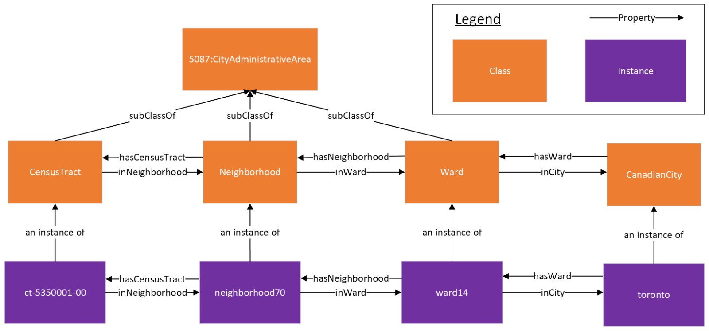
What is an Ontology?
A formal representation of knowledge that defines the concepts and relationships of a subject area
Consists of classes that define the concepts using formal logic and properties that define the relationships between classes or literal values
Provides a standardized interpretation of information to facilitate the sharing of knowledge
Notes:
Now that we have an understanding of what graph databases are, let's take a look at ontologies. An ontology is a formal representation of knowledge that defines the concepts and relationships of a subject area. They consist of classes which define the concepts using formal logic and properties that define the relationships. Ontologies provide us with a standardized interpretation of ideas to facilitate the sharing of knowledge. Here you can see an ontological representation of city administrative areas where the orange boxes represent classes, and the arrows represent properties. For example, in the center of the diagram, we can see that the ontology uses an "inWard" property to describe the relationship of a neighborhood being inside of a ward and the hasNeighborhood property to represent the inverse relationship.

Slide 5
How can we use ontologies to represent data in a graph database?
Use ontologies as a standardized representation of information
Map data onto the ontology
Data represented as RDF triplestores in a graph database
E.g., neighborhood70 inWard ward14
Notes:
This brings us to the question of how can we use ontologies to represent data in a graph database. From the previous slide, we learned that ontologies provide us with a standardized representation of information and this allows us to map data onto the ontology. Using the city administrative area ontology from the previous slide, we are now able to map a specific real world example where we can see that the instance neighborhood70 is inside of ward14 as represented using the "inWard" property from the ontology and this entity-relationship model can also be represented as an RDF triplestore for use in a graph database. Similarly, we can use this ontology to repeat this process and represent the relationships between other administrative areas.

Slide 6
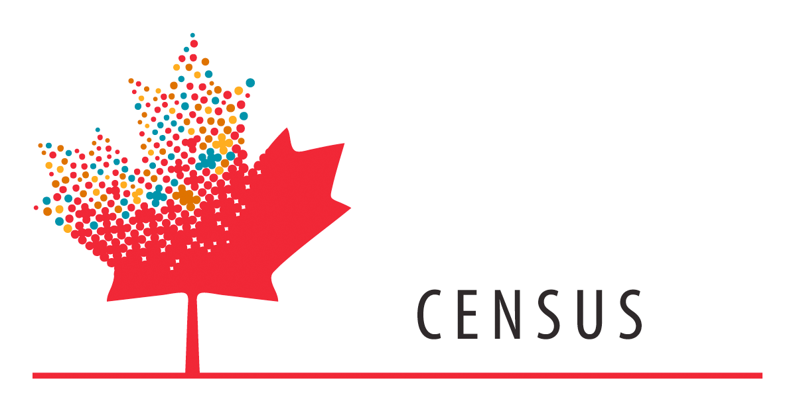

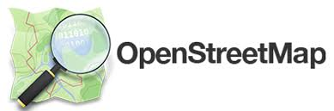
Integrating Data from Different Sources
Ontologies provide semantic interoperability
i.e., the ability share data with unambiguous, shared meaning
This enables the integration of data from different sources, for example…
Canadian Census Data
Toronto Police Service Open Crime Data
Complete Community Amenity data from OpenStreetMap
Notes:
As ontologies offer a formal representation of information, they provide semantic interoperability, that is, the ability to share data with unambiguous, shared meaning. This enables us to integrate data from different sources by mapping them onto an ontology. For example, our City Digital Twin contains demographic data from the Canadian Census, crime data from Toronto Police Service, and complete community amenity data from OpenStreetMap.

Slide 7
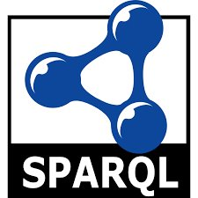
How can we use the data in a graph database?
Data can be queried using SPARQL
SPARQL (SPARQL Protocol and RDF Query Language) is a query language for Linked Open Data and RDF triplestores
Like SQL, SPARQL can be used to retrieve and modify data in graph databases
Notes:
So, how can we use the data stored in a graph database? We can query the data using SPARQL (which stands for SPARQL Protocol and RDF Query Language), a query language for Linked Open Data and RDF triplestores. Like SQL, we can use SPARQL to retrieve and modify data in graph databases.

Slide 8
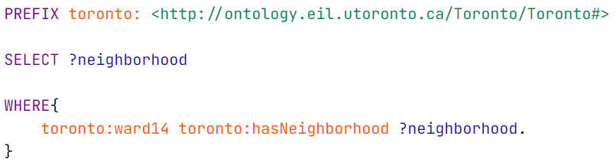
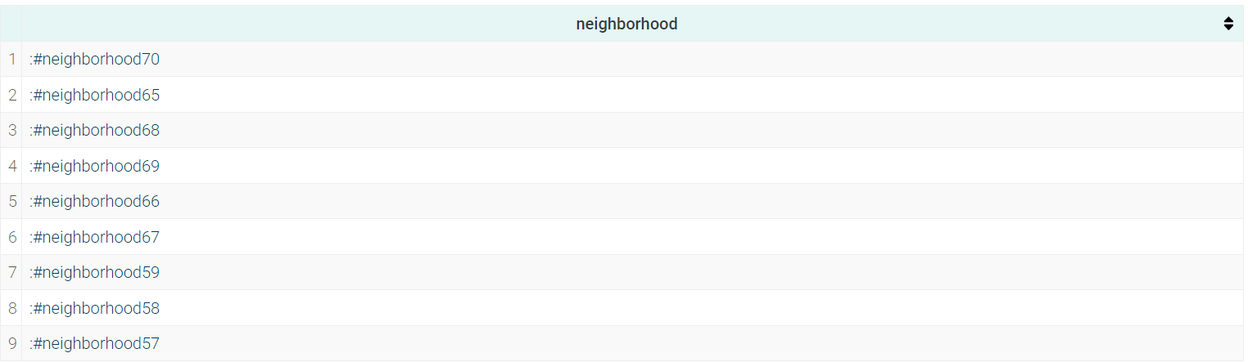
Simple SPARQL Query Example
Find all neighborhoods in ward14
PREFIX line declares a namespace prefix to shorten query
SELECT line retrieves values of "?neighborhood" variable
WHERE line identifies where to find values for the "?neighborhood" variable
Can replace "toronto:ward14" with a different ward to find neighborhoods in that ward
Notes:
Let's take a look at a simple SPARQL query example. From the city administrative area ontology, we know that we can use the hasNeighborhood property to find neighborhoods that are located in a specific ward. For this example, let's try to find all the neighborhoods in ward14 using this query. The PREFIX line declares a namespace prefix which allows us to shorten the query as we can use "toronto:" in place of "http://ontology.eil.utoronto.ca/Toronto/Toronto#". The SELECT line tells SPARQL to retrieve the values of the ?neighborhood variable. The WHERE line tells SPARQL where to find values for the ?neighborhood variable. In this case, we are telling SPARQL to give us the neighborhoods that are linked to ward14 using the hasNeighborhood property (i.e., the neighborhoods in ward 14). Running this query gives us the following list of results as seen in the table here. We could also replace "toronto:ward14" with a different ward to find neighborhoods in that ward instead.

Slide 9
City Digital Twin Applications
SPARQL queries allow applications to retrieve data from the City Digital Twin knowledge graph
Applications for data analysis, data visualization, etc.
City Digital Twin Dashboard
Link to GraphDB knowledge graph: http://ec2-3-97-59-180.ca-central-1.compute.amazonaws.com:7200/sparql
Notes:
SPARQL queries allow other applications to retrieve data from the City Digital Twin knowledge graph for data analysis and/or data visualization purposes. For example, our City Digital Twin Dashboard queries our knowledge graph using SPARQL via APIs to generate visualizations of city related data.

